Slide 1
Tasty Bytes was founded in 2020 in the midst of the Covid Pandemic. The world wanted inspiration so we decided to provide it. It started life as a search engine for recipes, helping people to find ways to use up the limited supplies they had at home. Now, over two years on, they are a fully fledged business. For a monthly subscription they will put together a full meal plan to ensure you and your family are getting a healthy, balanced diet whatever your budget. Subscriber to their premium plan also get ingredients delivered.
Tasty Bytes
BY
SALAMI LUKMAN BAYONLE
ON 10Th May 2023

Slide 2
Overview
This project seeks to Predict which recipes will lead to high traffic.
Correctly predict high traffic recipes 80% of the time
The Problem
Selecting the most appropriate recipes that influence the high traffic.
Determining the machine learning problem.

Slide 3
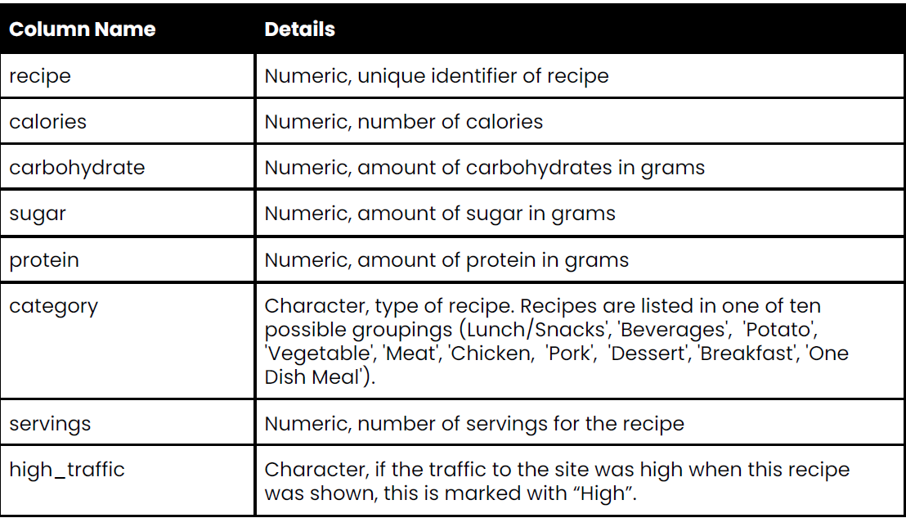
Data Validation

Slide 4
Data Validation
1. The Data was loaded using python pandas module in a jupyter notebook.
2. The data has 947 rows and 8 columns.
3. The category, servings and high_traffic columns are object type while the rest columns are either integer or float.
4. They are no duplicates in the dataset.
5. Several columns had null values.
For the high_traffic our data shows that the null values are actually not missing but low traffic. We imputed the null values as low_traffic.
The columns 'calories','carbohydrate','sugar','protein' columns are all right skewed with outliers. So we use the median as imputation for the null values.
6. The category column were listed in one of eleven (11) possible groupings instead of ten (10) possible groupings. The 'Chicken Breast' was merge with the 'Chicken' variable. We have 10 possible groupings after cleaning.
7. The servings column was presented as Six (6) possible instead of Four (4) possible groupings. The strings attached to some numbers were removed. We now have Four possible grouping of 1, 2, 4, 6. The column was also presented as object, we converted it back to numeric.

Slide 5
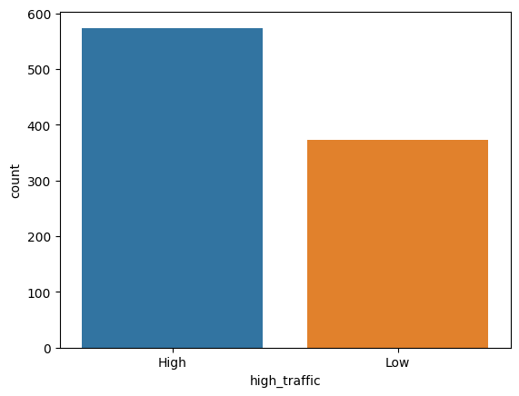
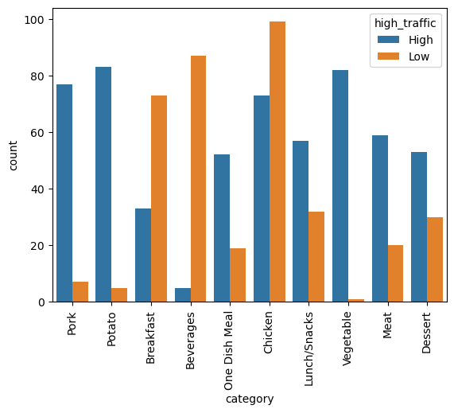
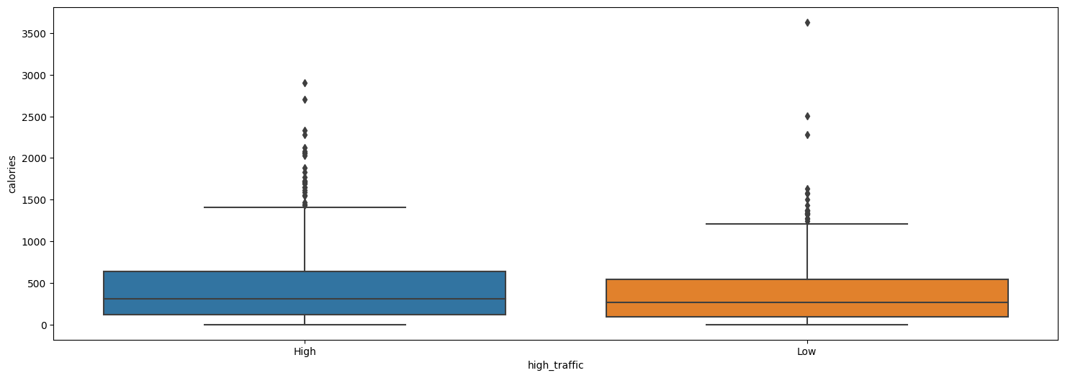
Exploratory Data Analysis
Observations
The category column is the most important feature.
The category(Pork,Potato,One Dish Meal, Vegetable, Meat, and Desert) contains in the recipe the higher traffic.
The servings, sugar, carbohydrates, calories has little or no significant effect on traffic.
The category(Beverages, Breakfast, and Chicken) contains in the recipe the lower the traffic.

Slide 6
Model Development
The is a Supervised Machine Learning Classification problem.
2. The class weight of high_traffic is not balance but it is not greatly unbalanced. We have 60% for High traffic and 40% for Low traffic.
3. We encoded the ‘category’ with dummy variables.
4. We separated our features and Target (‘high_traffic’) column and then split our data into train and test split.
5. We are using DecisionTreeClassifier has the baseline model.
6. We will use Logistic Regression has the comparison model.

Slide 7
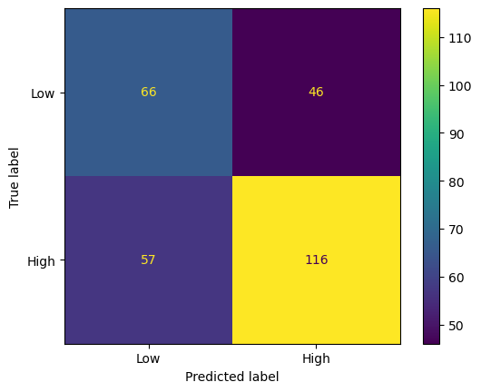
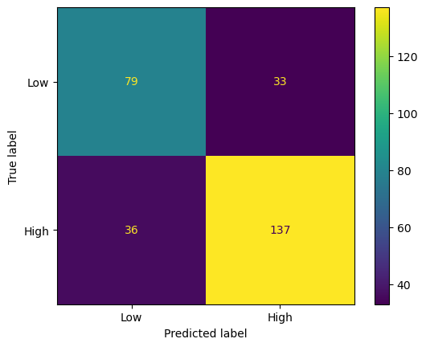
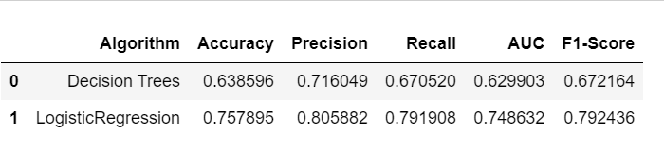
Model Evaluation
Baseline Model : Decision Trees Classifier.
Comparison Model : Logistic Regression

Slide 8
Definition of a metric for the business to monitor
Definition of a metric for the business to monitor
1. The business goal is to increase website traffic. More traffic means more subscriptions so this is really important to the company.
2. The Key Perfomance Indicators (KPI) in this case is the percentage of High traffic.
3. Establish a baseline: Choosing a favorite recipe from a selection and display that on the home page. We have noticed that traffic to the rest of the website goes up by as much as 40%.
4. With our baseline model we can predict the High traffic 72% while our comparision model can predict the High Traffic 81% using the precision metrics.

Slide 9
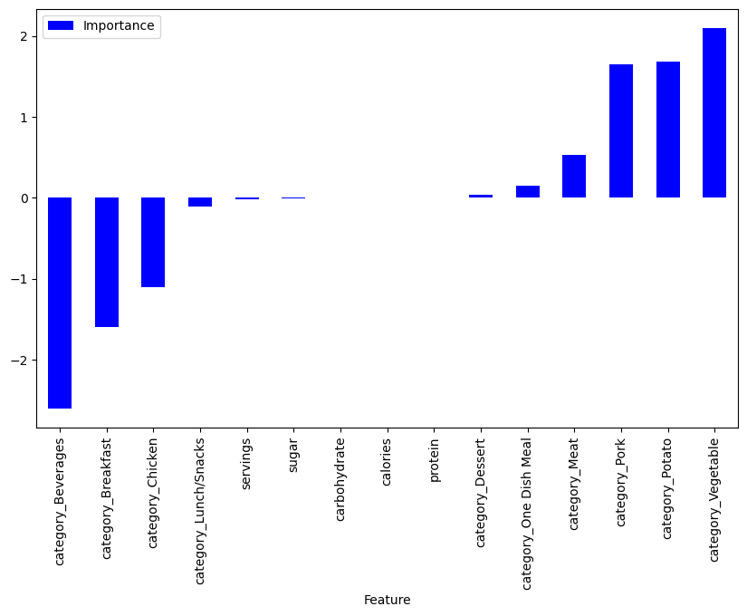
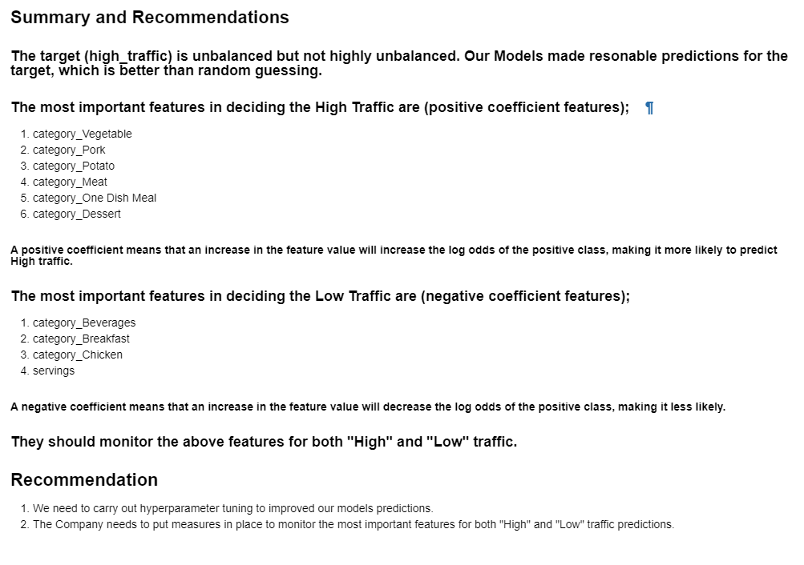
Summary

